Slide 1
DESIGN
THINKING

Slide 2
DIV – I GROUP 6
30.AASHISH KAPASE
31. SAHIL KAPASE
32.KAPIL SANGAMESHWAR
33.VED KAPRE
34.BHAKTI KAPASE
35.YOGITA KAPASE

Slide 3
Empathize
Define
5 Steps
Design Thinking
Test
Ideate
Prototype
3
Page

Slide 4
Empathize
Empathy is critical to the design thinking process because it allows designers to gain a deep understanding of the needs, desires, and behaviors of the people they are designing for. By empathizing with their experiences, designers can identify pain points and areas for improvement, which can inform the design of better solutions.
We will discuss on our topic of project we will consider assumptions what things can be done.
In this stage we will make a prototype which will be giving idea of our product
4
Page

Slide 5
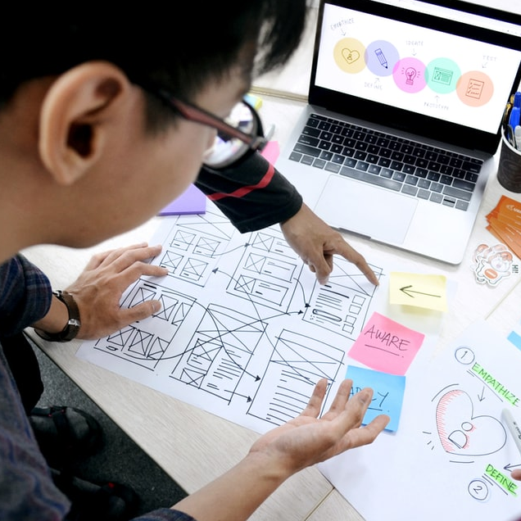

Define
Here you define the problem statement in a human-centered manner.
Analyze your observations from empathize phase to define the core problem.
Defining problems and problem statements must be done in a Human-centered manner.
5
Page

Slide 6

Ideate
You collect as many ideas as possible at the start, so your team can investigate and test them by the end
The ideation stage marks the transition from identifying problems to exploring solutions.
6
Page
Notes:
https://unsplash.com/photos/lFhyR3GVOXE

Slide 7
Prototype
A prototype is a draft version of a product that allows you to explore your ideas and show the intension behind a feature or the overall design concept to users before investing time and money into development.
Evaluation and feedback are essential
7
Page

Slide 8

Testing
Testing includes various difficult conditions that are imposed on the prototype which are basically the conditions the product might face in the real world.
The testing phase will quickly highlight any design flaws that need to be covered .
The results of the testing phase will often require you to run through a few more ideation sessions before you create that winning prototype.
We will be testing our product in this phase .if it is working properly or not if not we have to study on that part.
8
Page
Notes:
https://unsplash.com/photos/jJT2r2n7lYA

Slide 9
REFERENCES
https://ww w.culturepartnership.eu/en/article/ten-tools-for-design-thinking
Website: www.smaply.com. Website: www.stakeholder-management.com/.
Website: www.touchpointdashboard.com. Website: http://www.creately.com/. Website:
www.strategyzer.com. Website: www.axure.com/.

Slide 10
Thank You!

